Slide 1

Caribbean Studies

Slide 2
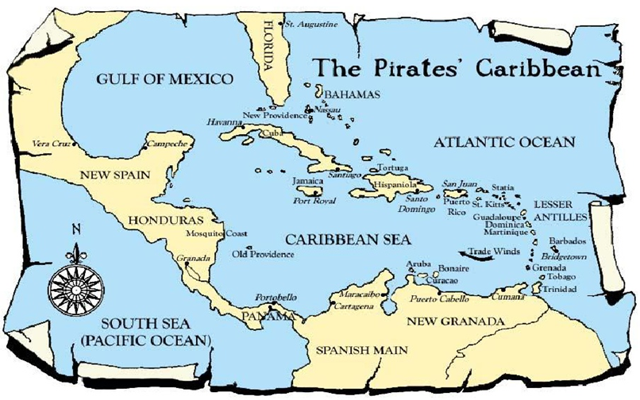

Slide 3

Introduction
CAS lends from the perspectives of humanities and social sciences to gain an understanding of Caribbean society & cultures.
The Caribbean region is defined in terms of common historical experiences, cultural identities, participation in the global community, intermixing of diverse ethnic and racial groups, and its ongoing fight for survival and sovereignty.

Slide 4
Objectives & Modules
Students will:
Study the effects of the physical, political and socio-economic factors on regions.
Review the aspects Culture, History, Ethics, Economics, Physical and Human Ecology to understand the Caribbean society and culture.
Decipher their role in preserving & contributing to their Caribbean heritage
Explore the significance of regional cooperation in the development of the Caribbean
Module 1: Society & Culture
Module 2; Geography & Culture
Module 3: The Caribbean & the Wider World
Module 4: Exploring Concept & Development

